Slide 1
YELP RESTAURANT
RECOMMENDER ENGINE
Capstone Project II | Nikki Seegars

Slide 2
PROBLEM STATEMENT
In any given city there are many restaurants that locals and tourists can patronize. In order to streamline users choices, a good recommender engine for Yelp (an online crowd sourced review website) will help to keep and drive more users to its website.

Slide 3
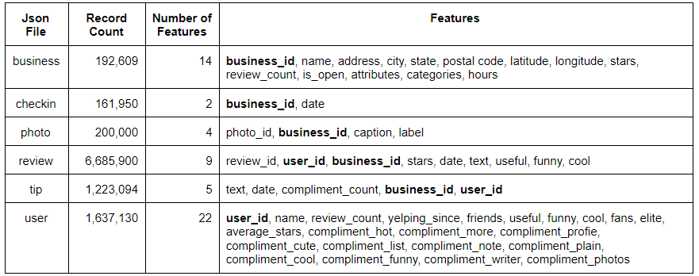
DATA SOURCES
Yelp has a public dataset available on it’s website for data analytic challenges and other academic purposes.

Slide 4
DATA WRANGLING
The following steps were taken to clean up the data:
Loaded json files to pandas DataFrame
Convert json to csv and save to file server
Import csv files into PostgreSQL database
Write query to summarize data
Load query into DataFrame
Update state designation for records incorrectly categorized

Slide 5
EXPLORATORY DATA ANALYSIS
Exploratory Data Analysis (EDA) was conducted by visually exploring the data to gather insights and trends from summary statistics.
Below are the features that were initially reviewed:
Open and closed restaurants
Restaurant count by state
Average star ratings by metropolitan area
Type restaurant types (categories)
Star ratings by increasing count

Slide 6
EXPLORATORY DATA ANALYSIS
Some restaurants are closed and were not included in the analysis.
193k total restaurants
82% of restaurants are open

Slide 7
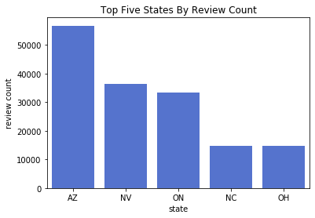
EXPLORATORY DATA ANALYSIS

Slide 8
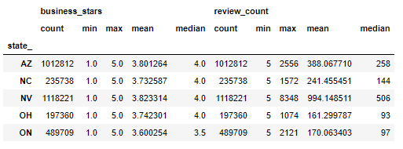
EXPLORATORY DATA ANALYSIS
The mean star rating across metropolitan areas is between 3.6 and 3.8 stars with Toronto (ON) having a slightly lower mean than the other metropolitan areas.

Slide 9
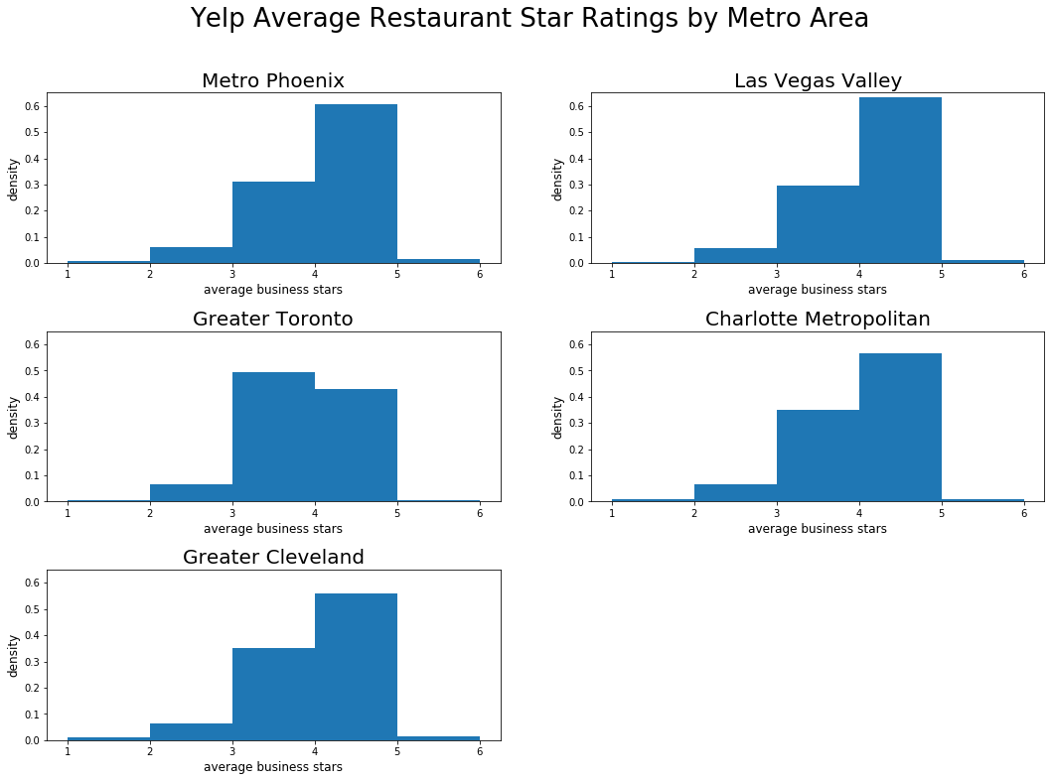
EXPLORATORY DATA ANALYSIS

Slide 10
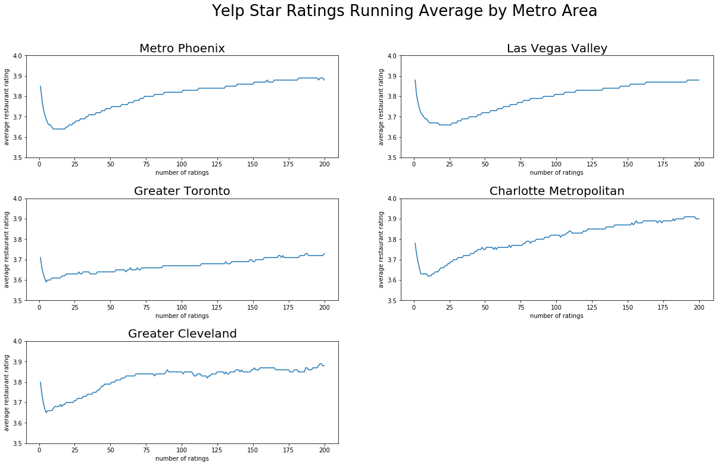
EXPLORATORY DATA ANALYSIS

Slide 11
MACHINE LEARNING
Machine learning is a branch of artificial intelligence that uses algorithms to learn without explicitly being programmed.
Machine Learning
Supervised Learning
Unsupervised Learning
Reinforcement Learning
output category labels are known
output category labels are not known
Interacts with the environment and learning is derived from past experiences

Slide 12
MACHINE LEARNING
Of the two types of supervised learning, classification is the appropriate choice for assigning each restaurant to a star rating of 1-5 with 1 being least favorable, and 5 being more favorable.
Supervised Learning
Regression
Classification
numerical and used to predict for a continuous value
categorical, used to predict for discrete classes

Slide 13
MACHINE LEARNING
Four classification models were considered and measured using precision and recall.
Algorithm | Precision (weighted average) | Recall (weighted average)
Custom Weighted Average | 0.34 | 0.30
Surprise BaselineOnly | 0.44 | 0.24
Surprise Matrix Factorization SVD | 0.55 | 0.25
Surprise KNNBasic | 0.38 | 0.27
Precision measures the proportion of positive identifications that are correct: True Positive /(True Positive + False Positive)
Recall measures the proportion of actual positives correctly identified: True Positive / (True Positive + False Negative)

Slide 14


MACHINE LEARNING
The Custom Weighted Average algorithm was the first to be executed and measured.

Slide 15
MACHINE LEARNING
The Surprise package in scikit surprise package offers several built-in algorithms with measurement functions for recommender engines.
The predictions algorithms used for this project were:
BaselineOnly
Matrix Factorization SVD
KNNBasic

Slide 16
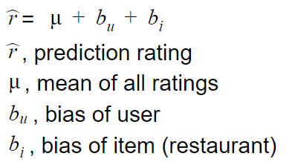
MACHINE LEARNING
The BaselineOnly algorithm makes prediction by using the mean of all ratings and adding bias for the both the user and item.

Slide 17
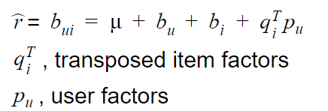
MACHINE LEARNING
The Matrix Factorization SVD algorithm adds on to the BaselineOnly algorithm using matrix multiplication and SVD that allows for highly dimensional and complex data to be reduced to a lower dimensional space to help find better features for classifying data..

Slide 18
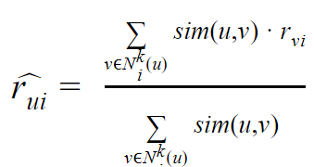
MACHINE LEARNING
The KNNBasic is a non-parametric algorithm that makes a classification decision based on its proximity to known data.

Slide 19
MACHINE LEARNING
Surprise Matrix Factorization SVD was chosen as the algorithm to use for this recommender engine since its precision score for was higher than all the rest of the algorithms and having the 2nd highest recall score.
Algorithm | Precision (weighted average) | Recall (weighted average)
Custom Weighted Average | 0.34 | 0.30
Surprise BaselineOnly | 0.44 | 0.24
Surprise Matrix Factorization SVD | 0.55 | 0.25
Surprise KNNBasic | 0.38 | 0.27

Slide 20
MACHINE LEARNING
The following parameters were tuned for the surprise matrix factorization SVD with the chosen values returning a precision of 0.56 and a recall 0f 0.24.
Parameter | Description | Tested Values | Chosen Value
n_factors | number of factors used in matrix | 3, 12, 50, 100 | 100
n_epochs | number of iteration of the stochastic gradient descent procedure | 5, 10, 20, 40 | 10
init_mean | mean of the normal distribution for factor vectors initialization | 0, 0.05, 0.1, 0.15 | 0
init_std_dev | standard deviation of the normal distribution for factor vectors initialization | 0, 0.05, 0.1, 0.15 | 0.1
lr_all | learning rate for all parameters | 0.001, 0.003, 0.005, 0.007 | 0.007
reg_all | regularization term for all parameters | 0.01, 0.02, 0.03, 0.04 | 0.04

Slide 21
MACHINE LEARNING
The following parameters were tuned for the surprise matrix factorization SVD with the chosen values returning a precision of 0.56 and a recall 0f 0.24.
Parameter | Description | Tested Values | Chosen Value
n_factors | number of factors used in matrix | 3, 12, 50, 100 | 100
n_epochs | number of iteration of the stochastic gradient descent procedure | 5, 10, 20, 40 | 10
init_mean | mean of the normal distribution for factor vectors initialization | 0, 0.05, 0.1, 0.15 | 0
init_std_dev | standard deviation of the normal distribution for factor vectors initialization | 0, 0.05, 0.1, 0.15 | 0.1
lr_all | learning rate for all parameters | 0.001, 0.003, 0.005, 0.007 | 0.007
reg_all | regularization term for all parameters | 0.01, 0.02, 0.03, 0.04 | 0.04

Slide 22
MACHINE LEARNING
Since the purpose is to recommend items, each of the ratings were converted to binary labels, 0 and 1 with 1 indicating a recommendation.
Each record in the test set was converted to a 1 if the user rating was >= 4
The prediction used 3.5 as the threshold for if the restaurant was counted as a recommendation
The updated precision was 0.67 and recall was 0.69

Slide 23
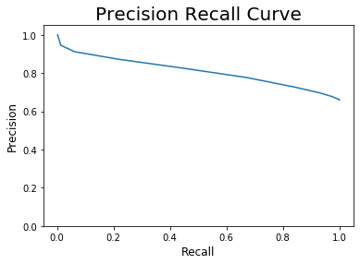
MACHINE LEARNING
In addition the precision recall curve using many thresholds between 1-5 resulted in an area under the curve of 0.80798.

Slide 24
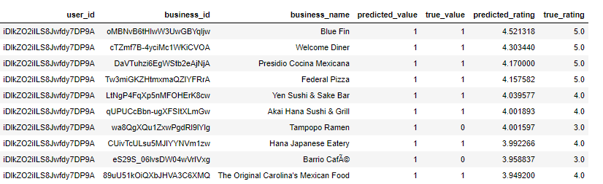
MACHINE LEARNING
Finally, the restaurant recommendation were given sorted by highest to lowest prediction rating.

Slide 25
CONCLUSION
A subset of restaurant categories (Italian, Japanese, Mexican and Burgers) was used for this recommender engine but additional categories can be added, however additional computing resources will be required
The user-restaurant matrix was very sparse (~99.9%) and makes the recommender engine less accurate with precision and recall scores for star ratings
Focusing only on if a restaurant should be recommend (prediction >=3.5) improves the precision and recall scores in this model

